Slide 1

AI-BASED TUTOR FOR VISUALLY IMPAIRED STUDENTS
Presented By
M.NITHEESH KUMAR ,R.DHANVANTHRI , R.NITHISH SELVAM , M.PUGALENTHI Kalasalingam Academy of Research and Education
Project Guide:
Dr.M.Jayalakhsmi

Slide 2
Problem Statement
In today’s digital learning environment, most educational platforms and study materials are designed primarily for visually capable users, making them difficult for visually impaired students to access and understand independently.
Although assistive tools like screen readers are available, they only provide basic text reading functionality and lack intelligent interaction, contextual understanding, and personalized learning support.
As a result, visually impaired learners often depend on others to interpret educational content, which limits their independence, reduces learning efficiency, and affects their overall academic experience.
Therefore, there is a need for an intelligent, voice-based system that can not only read content but also understand user queries, explain concepts, summarize information, and provide an interactive learning experience for visually impaired students.

Slide 3
Literature Review
Study | Model | Year | Inputs | Accuracy
Chan & Cooley [1] | HMM-based Speech Recognition | 2013 | Speech Signals | Limited accuracy in noisy environments
Jurafsky & Martin [2] | NLP & Deep Learning Models | 2021 | Text & Speech Data | Improved language understanding
Google Speech API [3] | Deep Neural Networks | 2023 | Voice Input | High accuracy speech-to-text
Google gTTS [4] | Text-to-Speech System | 2023 | Text Data | Natural audio output generation
Proposed System (Ours) | AI + NLP + Voice Integration | 2026 | Voice + PDF Documents | Intelligent, interactive learning system

Slide 4
Exisisting System Overview
Existing assistive learning systems for visually impaired users mainly rely on screen readers and basic voice assistants. These systems convert text into speech, allowing users to listen to digital content such as documents and web pages.
However, they provide only one-way interaction, where the system reads the content without understanding the context or user queries. Most systems lack intelligent processing capabilities, such as explaining complex topics, summarizing information, or generating meaningful responses.
Additionally, these tools do not support interactive learning features and fail to recognize user intent effectively. As a result, users often face difficulty in understanding content and still depend on external assistance for better learning.

Slide 5
Proposed Methodology
The proposed system is an AI-Based Voice Tutor designed to provide an interactive and accessible learning experience for visually impaired students. The system allows users to interact completely through voice commands, eliminating the need for visual interfaces.
The methodology begins with capturing user input through speech recognition, where voice is converted into text. The system then processes uploaded PDF documents, extracting and organizing the content for further analysis.
An intent recognition module analyzes the user’s query to understand the required action, such as summarization, explanation, or translation. Based on this, the AI model (Gemini API) generates meaningful and context-aware responses.
Finally, the generated response is converted into audio using text-to-speech technology (gTTS), providing a clear and natural voice output. This complete workflow ensures a seamless, intelligent, and voice-driven learning process for users.

Slide 6
Modules with description
2nd International Conference on Artificial Intelligence for Innovations in Healthcare Industries (ICAIIHI 2025)
Technically Co-Sponsored by: IEEE Computer Society, IEEE Computer Society Technical Committee on Intelligent Informatics (TCII)
Date: December 4 & 5, 2025 (Hybrid Mode)
Dataset selection:
Voice Recognition Module This module captures the user’s voice input and converts it into text using speech recognition technology. It allows visually impaired users to interact with the system without using a keyboard.
PDF Processing Module This module handles the uploaded PDF documents and extracts the text content. The extracted data is then prepared for further processing by the system.
Intent Recognition Module This module analyzes the user’s input and identifies what the user wants, such as summarization, explanation, or translation. It helps the system understand the user’s request clearly.
AI Response Module This module uses the AI model (Gemini API) to generate meaningful and context-based responses based on the user query and document content.

Slide 7
2nd International Conference on Artificial Intelligence for Innovations in Healthcare Industries (ICAIIHI 2025)
Technically Co-Sponsored by: IEEE Computer Society, IEEE Computer Society Technical Committee on Intelligent Informatics (TCII)
Date: December 4 & 5, 2025 (Hybrid Mode)
Text-to-Speech Module This module converts the generated text response into audio output using text-to-speech technology, making it easy for users to listen and understand.
Frontend Module This module provides the user interface where users can interact with the system through voice commands and upload documents.
Backend Module This module manages the overall system operations, including processing requests, handling APIs, and connecting all modules together.

Slide 8
Software Requirements
2nd International Conference on Artificial Intelligence for Innovations in Healthcare Industries (ICAIIHI 2025)
Technically Co-Sponsored by: IEEE Computer Society, IEEE Computer Society Technical Committee on Intelligent Informatics (TCII)
Date: December 4 & 5, 2025 (Hybrid Mode)
Programming Language Python
Frontend Technologies HTML, CSS, JavaScript
Libraries & Frameworks Flask (backend framework), SpeechRecognition / Web Speech API (voice input), gTTS (text-to-speech conversion), PyPDF2, pdfplumber (PDF processing), Tesseract OCR (optional text extraction)
Artificial Intelligence Google Gemini API (AI response generation)
Tools & Environment Visual Studio Code
Deployment Flask Server

Slide 9
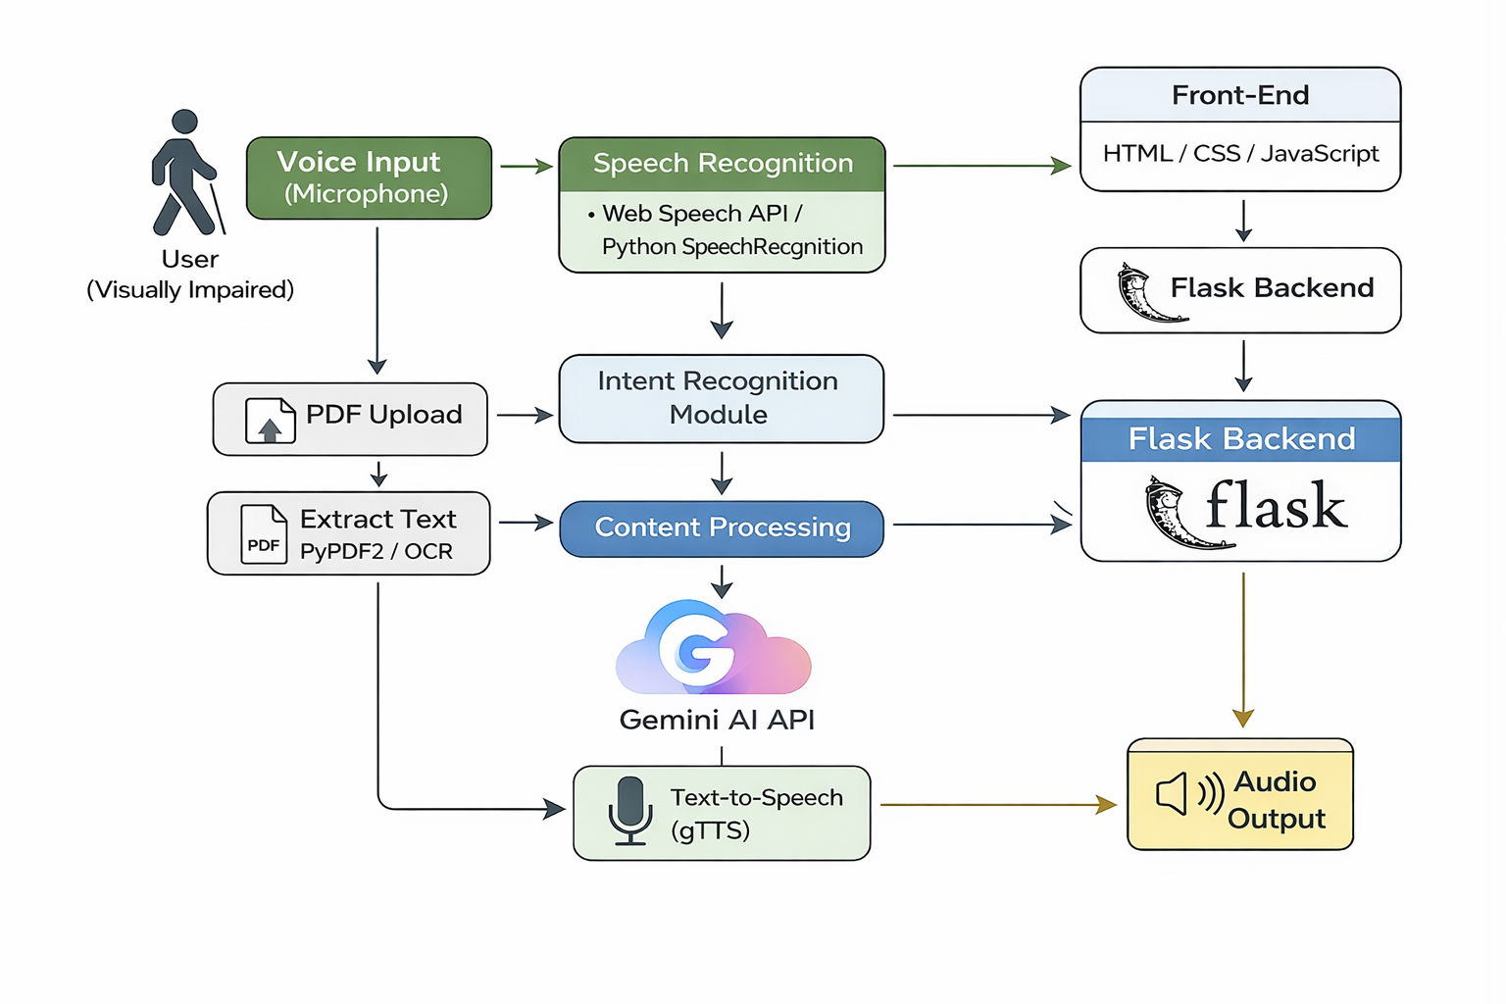
System Architecture
2nd International Conference on Artificial Intelligence for Innovations in Healthcare Industries (ICAIIHI 2025)
Technically Co-Sponsored by: IEEE Computer Society, IEEE Computer Society Technical Committee on Intelligent Informatics (TCII)
Date: December 4 & 5, 2025 (Hybrid Mode)

Slide 10
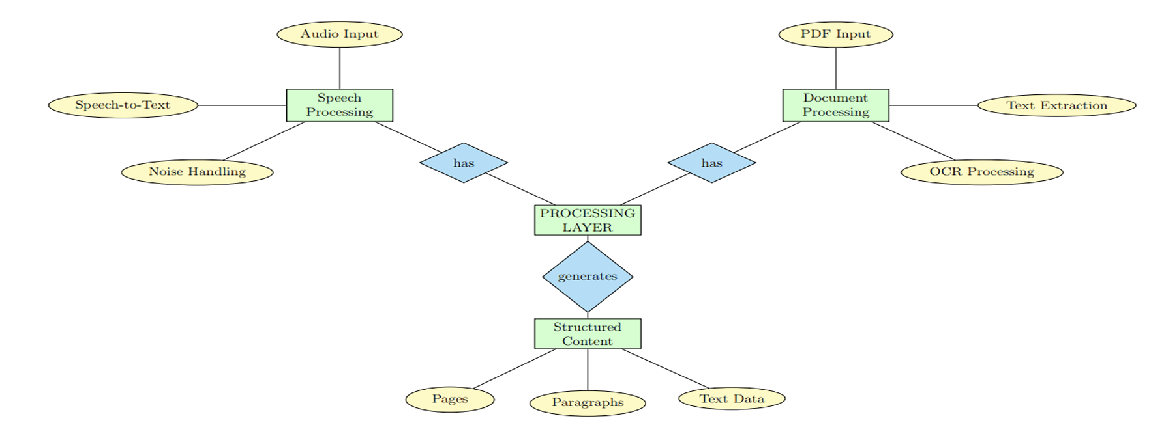
Flow Diagram
2nd International Conference on Artificial Intelligence for Innovations in Healthcare Industries (ICAIIHI 2025)
Technically Co-Sponsored by: IEEE Computer Society, IEEE Computer Society Technical Committee on Intelligent Informatics (TCII)
Date: December 4 & 5, 2025 (Hybrid Mode)

Slide 11
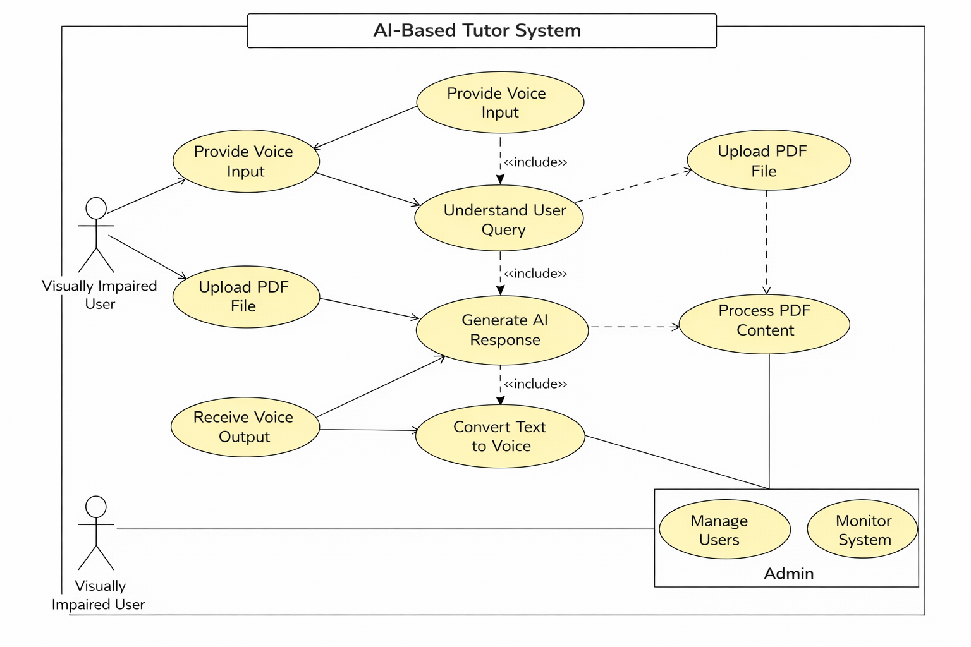
UML diagram
2nd International Conference on Artificial Intelligence for Innovations in Healthcare Industries (ICAIIHI 2025)
Technically Co-Sponsored by: IEEE Computer Society, IEEE Computer Society Technical Committee on Intelligent Informatics (TCII)
Date: December 4 & 5, 2025 (Hybrid Mode)

Slide 12
Results
2nd International Conference on Artificial Intelligence for Innovations in Healthcare Industries (ICAIIHI 2025)
Technically Co-Sponsored by: IEEE Computer Society, IEEE Computer Society Technical Committee on Intelligent Informatics (TCII)
Date: December 4 & 5, 2025 (Hybrid Mode)
The AI based voice tutor system was developed and tested to help visually impaired students in learning.
The system takes voice input from the user, converts it into text, processes it using AI and gives the response in voice format, so it is easy to understand.
It also supports PDF input where users can upload study materials and get explanations in a simple way.
During testing, the system worked well and was able to give accurate responses most of the time.
It helps students learn independently without depending on others and makes learning more interactive.
However, there are still some improvements needed like better speech recognition and faster response time.

Slide 13
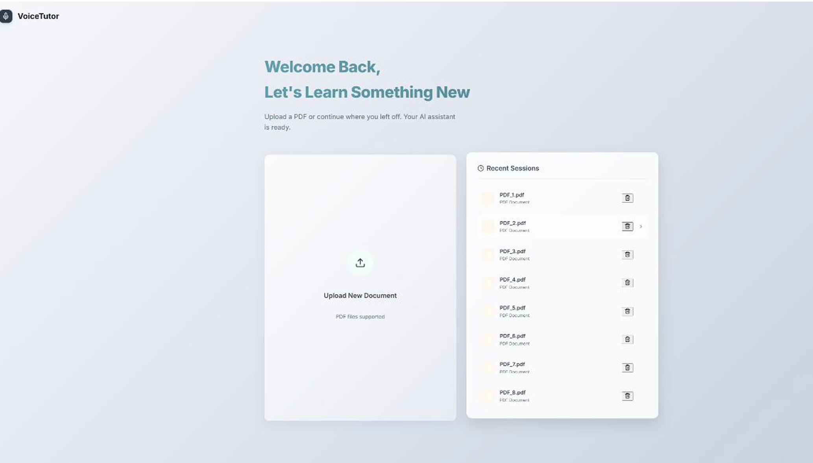
2nd International Conference on Artificial Intelligence for Innovations in Healthcare Industries (ICAIIHI 2025)
Technically Co-Sponsored by: IEEE Computer Society, IEEE Computer Society Technical Committee on Intelligent Informatics (TCII)
Date: December 4 & 5, 2025 (Hybrid Mode)

Slide 14
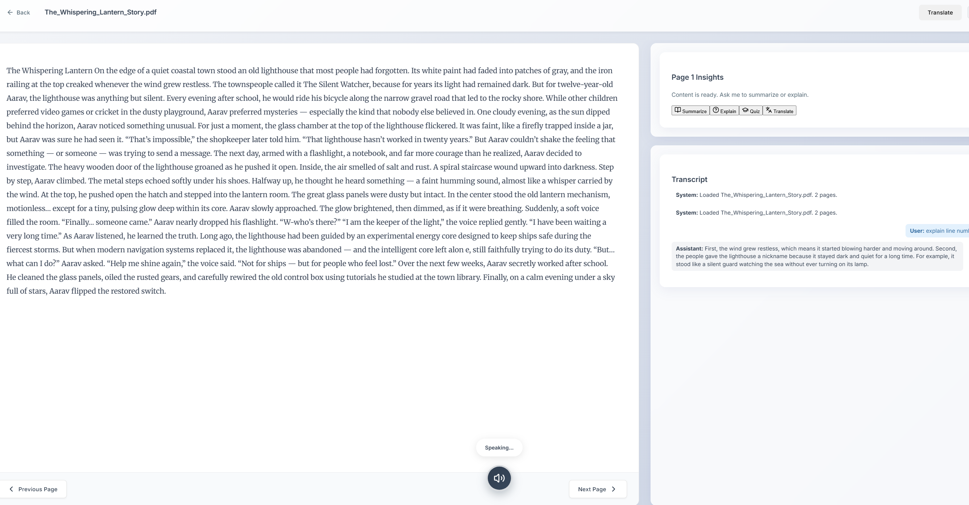
2nd International Conference on Artificial Intelligence for Innovations in Healthcare Industries (ICAIIHI 2025)
Technically Co-Sponsored by: IEEE Computer Society, IEEE Computer Society Technical Committee on Intelligent Informatics (TCII)
Date: December 4 & 5, 2025 (Hybrid Mode)

Slide 15
Conclusion
2nd International Conference on Artificial Intelligence for Innovations in Healthcare Industries (ICAIIHI 2025)
Technically Co-Sponsored by: IEEE Computer Society, IEEE Computer Society Technical Committee on Intelligent Informatics (TCII)
Date: December 4 & 5, 2025 (Hybrid Mode)
The AI based voice tutor system is developed to make learning easier for visually impaired students.
It allows users to interact through voice, understand their queries, and provide responses in an accessible way.
The system also supports PDF input, which helps users to study materials independently without needing help from others.
Overall, this project improves accessibility, makes learning more interactive, and reduces dependency on external support. Even though the system works well, there is still scope for improvement in terms of accuracy and performance.

Slide 16
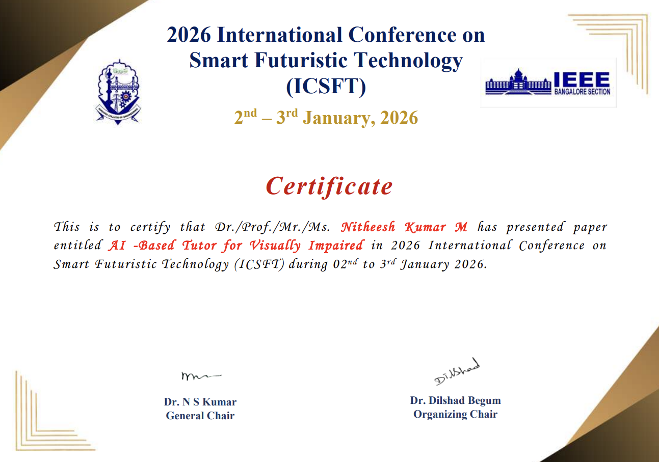
2nd International Conference on Artificial Intelligence for Innovations in Healthcare Industries (ICAIIHI 2025)
Technically Co-Sponsored by: IEEE Computer Society, IEEE Computer Society Technical Committee on Intelligent Informatics (TCII)
Date: December 4 & 5, 2025 (Hybrid Mode)

Slide 17
Reference
2nd International Conference on Artificial Intelligence for Innovations in Healthcare Industries (ICAIIHI 2025)
Technically Co-Sponsored by: IEEE Computer Society, IEEE Computer Society Technical Committee on Intelligent Informatics (TCII)
Date: December 4 & 5, 2025 (Hybrid Mode)
[1] Liang, Huanwen, Yu Lu, Qianying Liu, and Xianghua Fu, “Fully automatic classification of cardiotocographic signals with 1D-CNN and bi-directional GRU,” Proceedings of the 44th IEEE EMBC, 2022, pp. 4590–4594.
[2] Huang, Zhuya, Junsheng Yu, and Ying Shan, “A multimodal deep learning-based algorithm for specific fetal heart rate events detection,” Biomedical Engineering / Biomedizinische Technik, vol. 70, no. 2, pp. 183–194, 2025.
[3] Rao, Lin, Jia Lu, Hai-Rong Wu, Shu Zhao, Bang-Chun Lu, and Hong Li, “Automatic classification of fetal heart rate based on a multi-scale LSTM network,” Frontiers in Physiology, vol. 15, 2024.
[4] Deng, Yanjun, Yefei Zhang, Zhixin Zhou, Xianfei Zhang, Pengfei Jiao, and Zhidong Zhao, “A lightweight fetal distress-assisted diagnosis model based on a cross-channel interactive attention mechanism,” Frontiers in Physiology, vol. 14, 2023.
[5] PhysioNet, “Non-Invasive Fetal ECG Database,” Available: https://physionet.org/content/nifecgdb/1.0.0/

